Slide 1
Zero Waste Cities
Greetings from Europe
Zerowasteeurope.eu
Zero Waste Cities - Greetings from Europe

Slide 2
The story of
Zero Waste
Cities
Zero Waste Cities - Greetings from Europe

Slide 3
Started in Capannori, Italy in 2007 where the locals transformed their waste management system to avoid building an incinerator.
Over the years, others followed, growing the network of cities: 440+ in 2021.
New cities, from Riga to Barcelona, are committing to go zero waste. First Certified Zero Waste Cities in April 2022
Learnings were gathered, formalised and harmonised: Zero Waste Cities Certification launched in March 2021.
Zero Waste Cities - Greetings from Europe

Slide 4
What has changed
Original model vs Certification:
Third party verification of results -> more robust and credible.
More granular requirements for the cities -> acts also as a to-do list.
More objective performance evaluation -> relevant feedback and harmonized results.
Data collection -> possibility to measure impacts.
Levels of performance -> goals to reach
Mechanisms to address underperformance -> possibility to lose zero waste status.
Zero Waste Cities - Greetings from Europe
With the launch of the Certification system, the interest in zero waste cities has expanded to new countries in Europe as well as to the largest cities in the continent.

Slide 5
The Zero Waste
Cities Certification
model, as ran by
the Mission Zero
Academy
Zero Waste Cities - Greetings from Europe

Slide 6
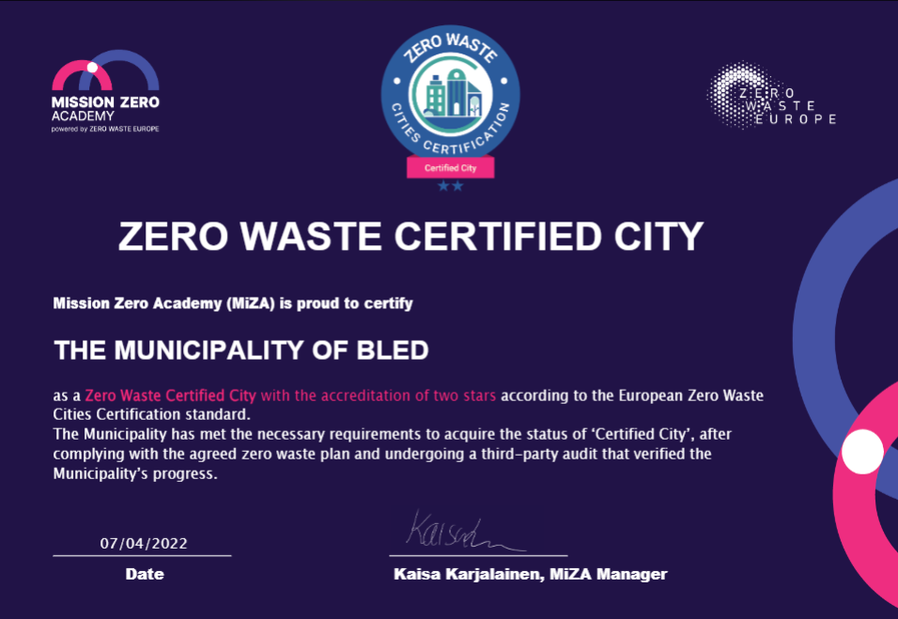
State of play
Currently certified:
x1
x3
Zero Waste Cities - Greetings from Europe
Existing Certified Cities from Italy, Spain and Slovenia.
First audit in Germany in 2 weeks.
Currently searching for dates for 7 other cities.
x5
x2

Slide 7
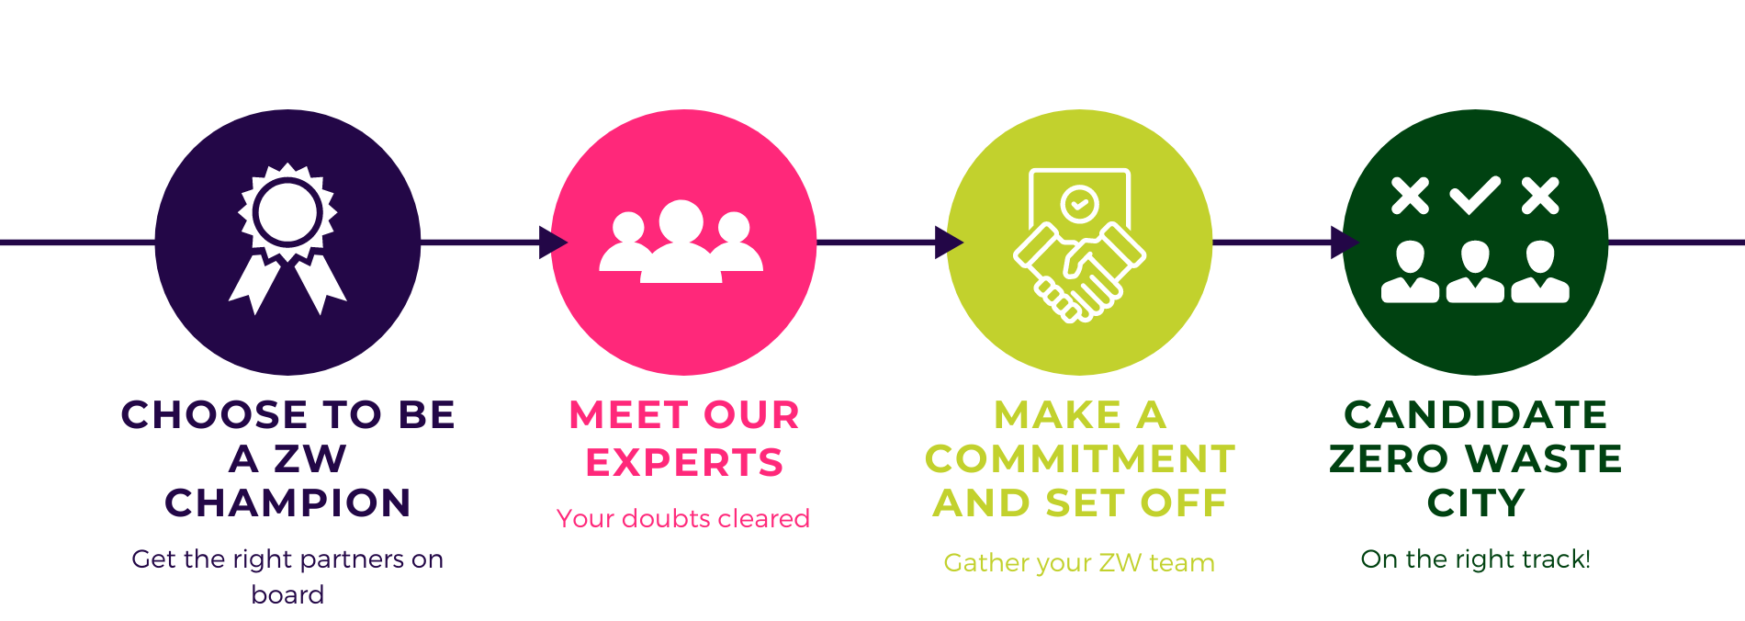
Becoming a Candidate City
Zero Waste Cities - Greetings from Europe

Slide 8
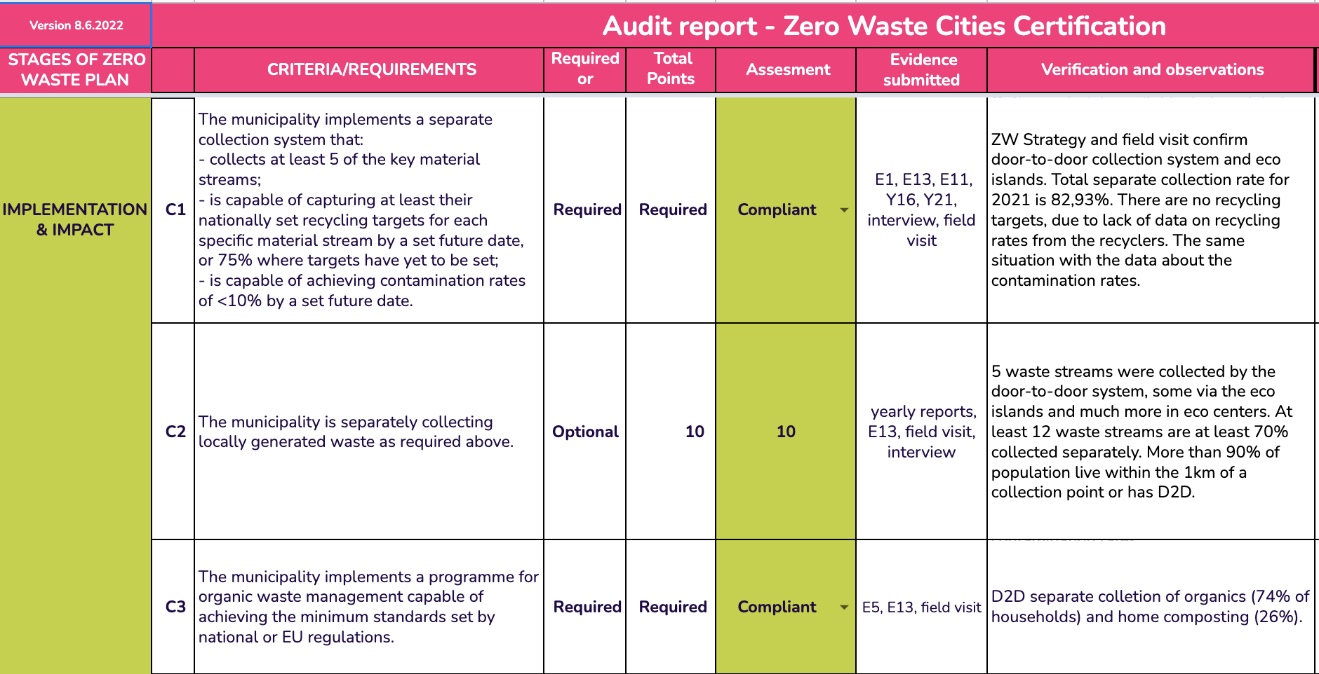
Becoming certified
Zero Waste Cities - Greetings from Europe

Slide 9
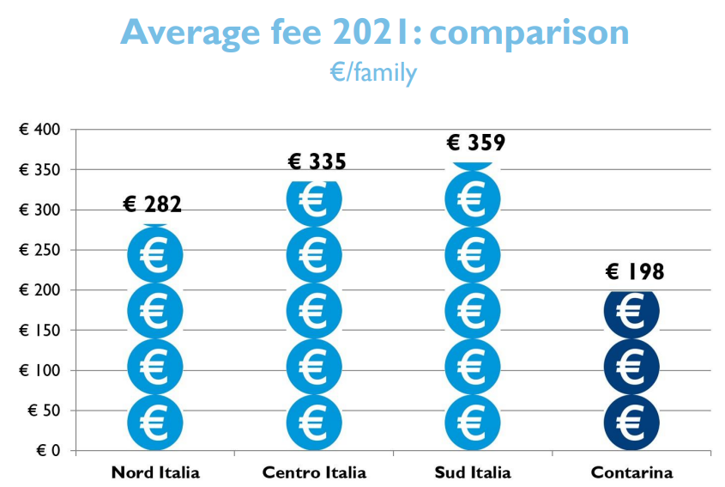
Building on success
Average separate collection rate of 67% (ranging from 7% to 93%
Average total MSW generation of 342kgs per capita - 160kgs less than the EU average in 2020
Zero Waste Cities - Greetings from Europe

Slide 10
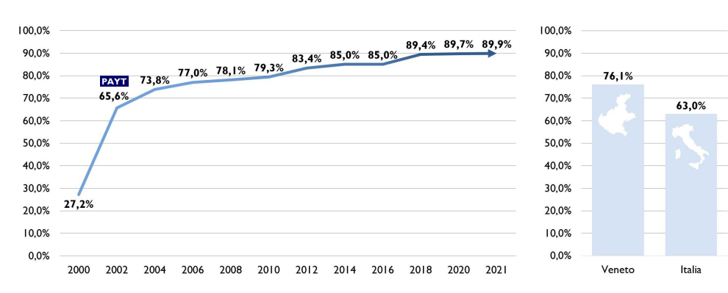
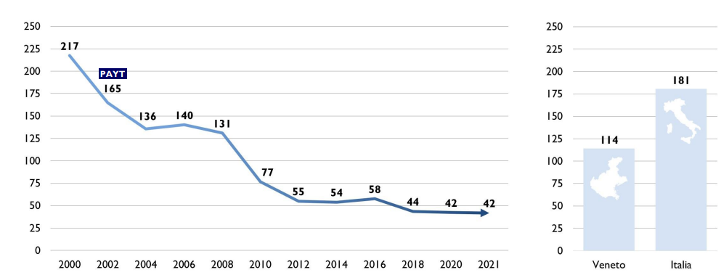
Treviso region, Italy
Separate collection rate
Zero Waste Cities - Greetings from Europe
Residual waste per capita (kg)

Slide 11
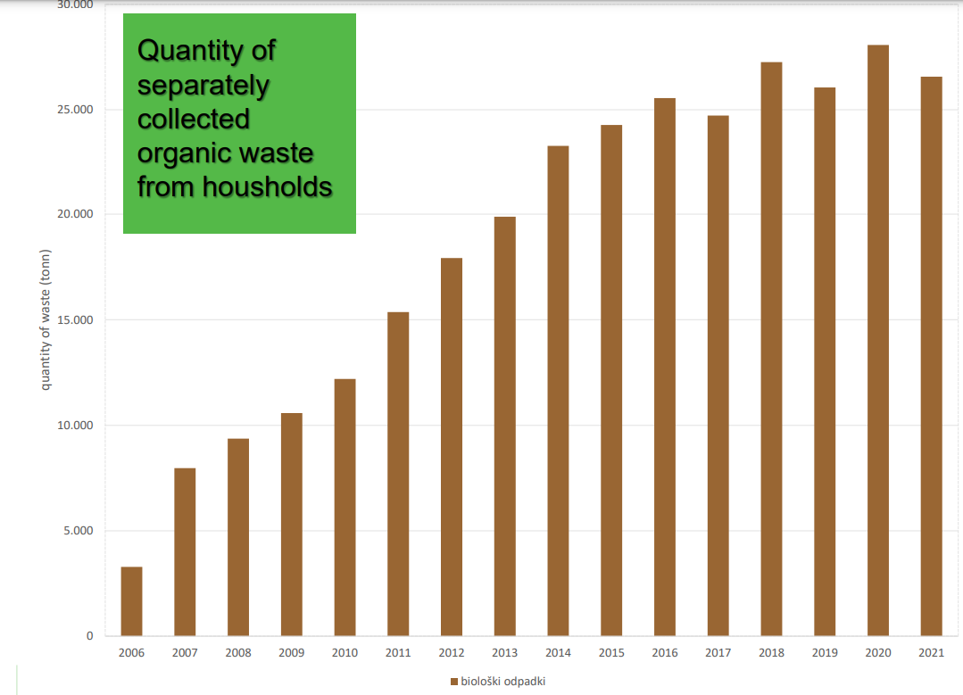
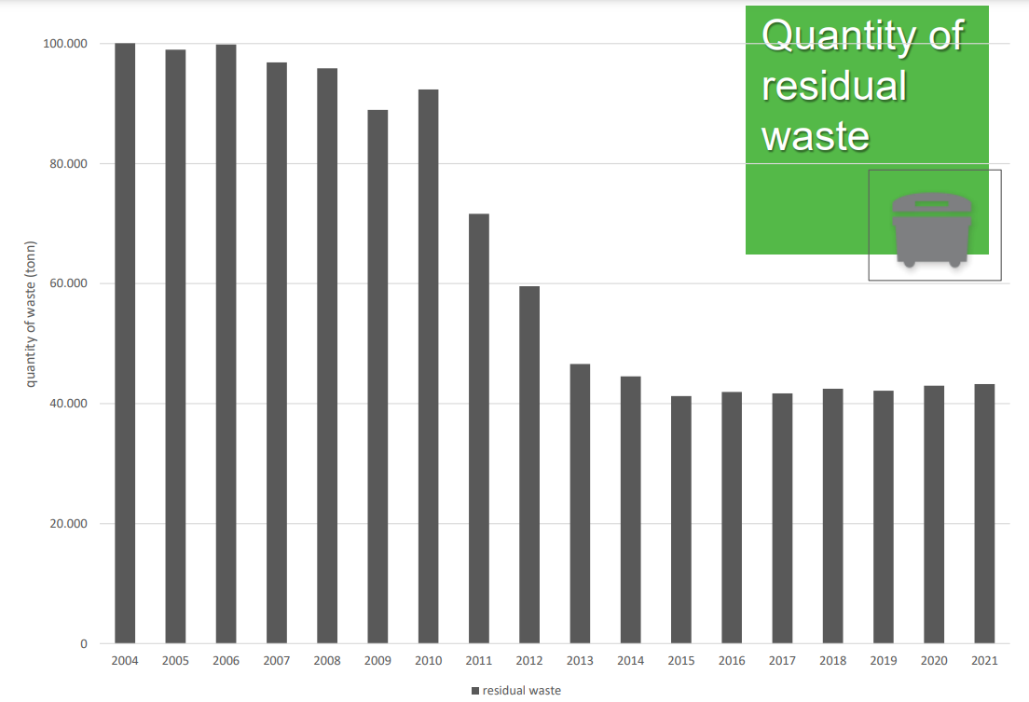
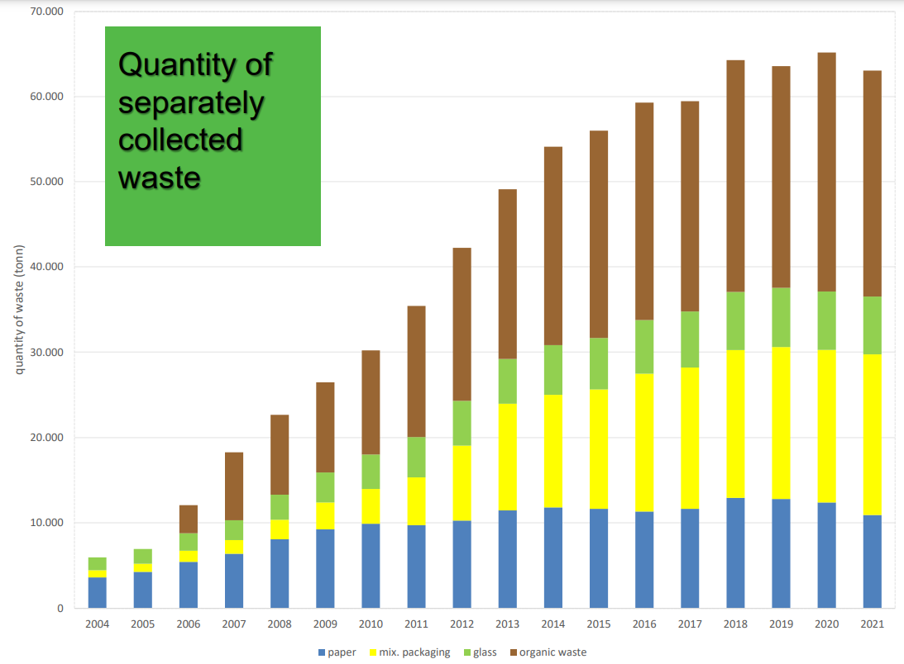
Ljubljana, Slovenia
Zero Waste Cities - Greetings from Europe

Slide 12
What’s next?
Candidate Cities:
Coming soon:
Kreis Höxter (Germany)
Munich (Germany)
Partizanske and Kosece (Slovakia)
Barcelona (Spain)
Riga (Latvia)
Guimarães, São João da Madeira, Vila de Rei (Portugal)
Svilengrad, Gabovo (Bulgaria)
Ipsonas (Cyprus)
Island of Krk (Croatia)
Island of Tilos (Greece)
Leipzig (Germany)
Berlin (Germany)
Frankfurt (Germany)
Cologne (Germany)
Ibiza (Spain)
Bornholm (Denmark)
Alvito (Portugal)
Kranj (Slovenia)
Zagreb (Croatia)
Zero Waste Cities - Greetings from Europe
…and many more!

Slide 13
Thank you
#ZeroWasteCities
#MissionZeroAcademy
Zerowasteeurope.eu
Zerowastecities.eu
Missionzeroacademy.eu
Zero Waste Cities - Greetings from Europe
Kaisa Karjalainen,
Manager, Mission Zero Academy by Zero Waste Europe

