Slide 2
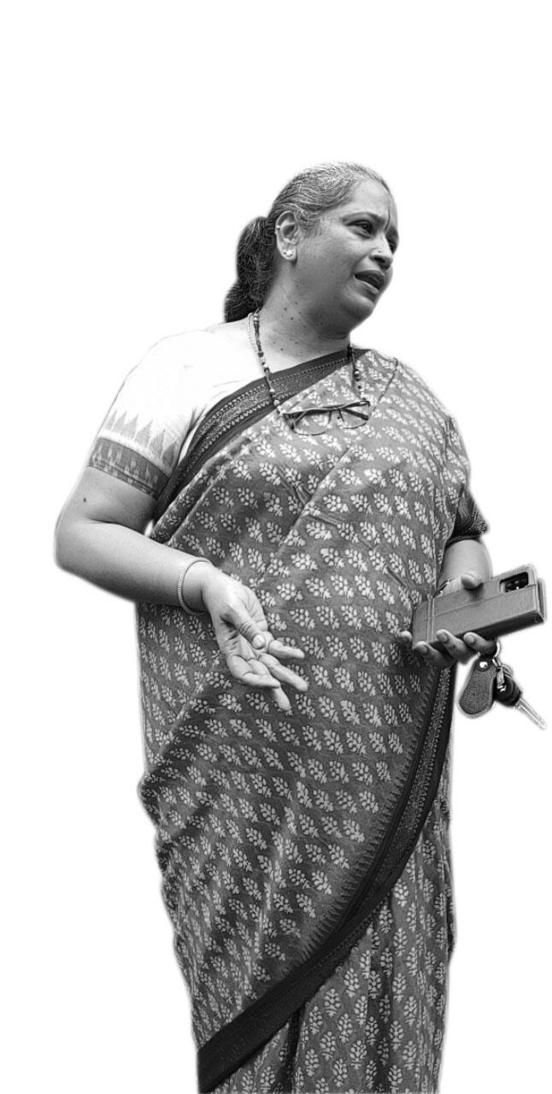
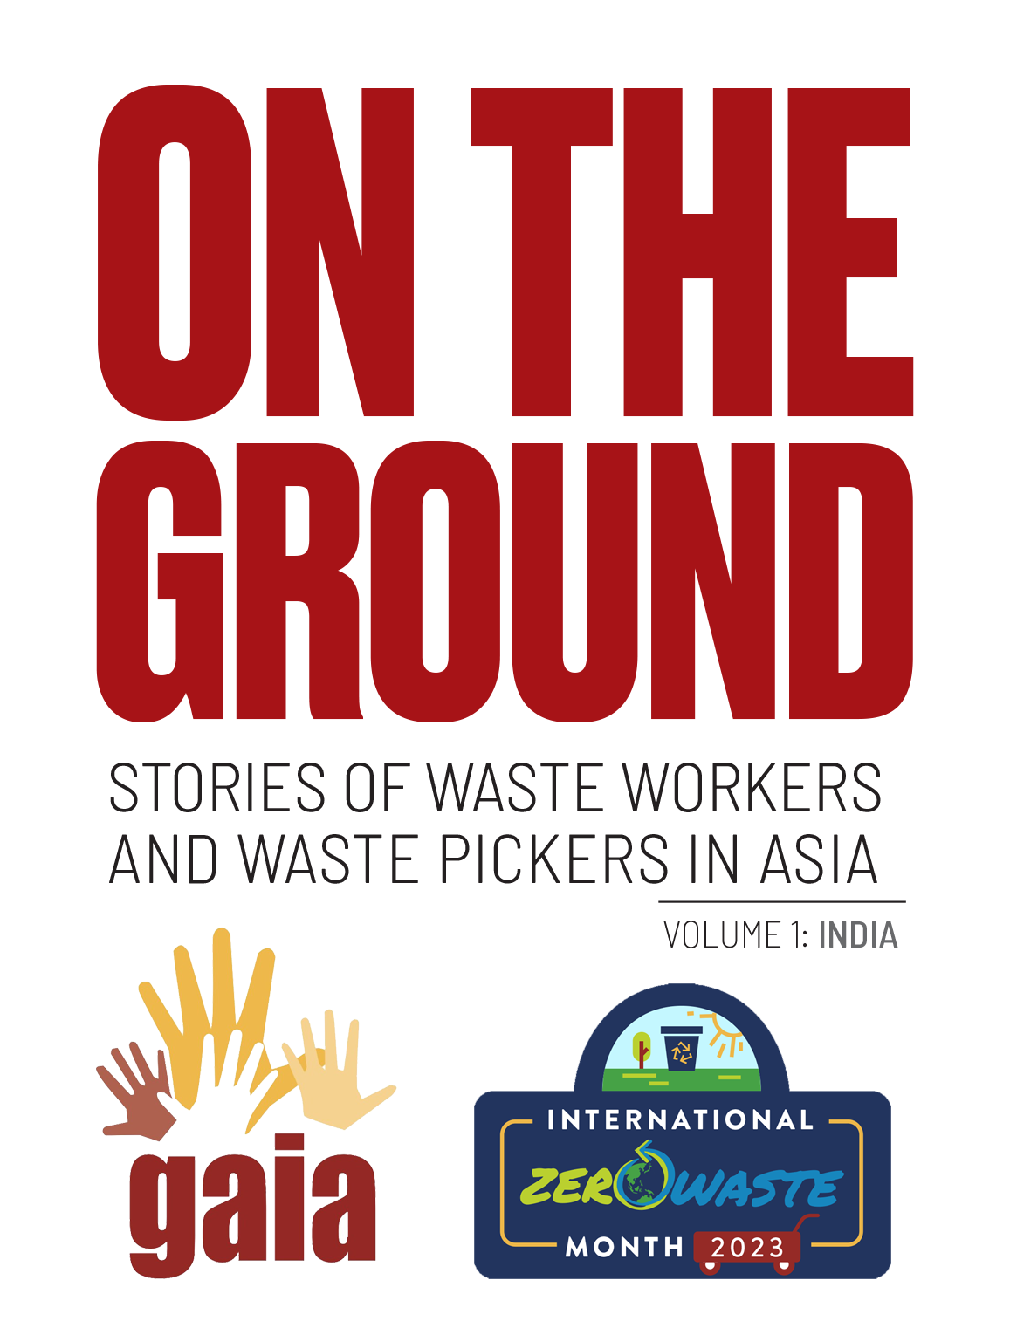
“When we are born, we are issued a birth certificate. Many of the waste pickers who belonged to the Dalit community … didn't have any kind of identity, even though they have stayed in the community for ages.
“So my main issue was how to integrate waste pickers in the local solid waste management system so they could have predictable income, and at the same time, look at how they could access social security or social entitlement.
NALINI SHEKAR
Co-Founder, Hasiru Dala
Bangalore, India

Slide 3
I was barely eight years old when I started working as a waste picker. My father died, and my mother had no other option than to bring me and my baby brother with her. It was difficult. We were chased by dogs, and men openly stared at my mother. She was very young when she was widowed.
SUSHILA
Waste Picker
Stree Mukti Sanghatana

Slide 4
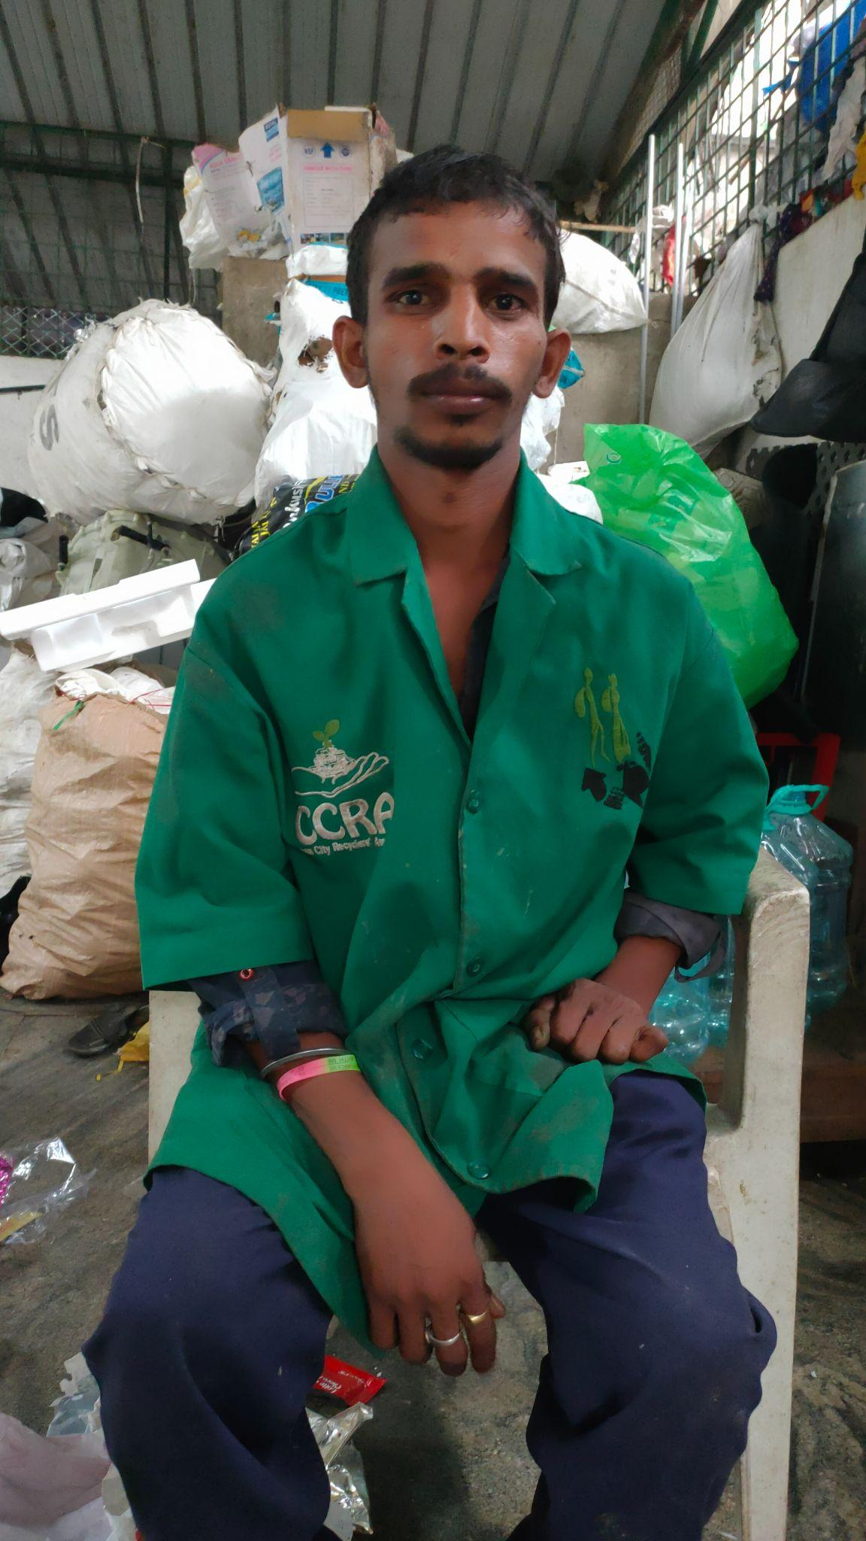
I lost my parents when I was a young kid. Then my brother and sister also died. They died of TB. Suddenly, I was all alone. I was homeless. I lived with my friends in the streets. We ate whatever food we could find. Even the stale ones. We were very hungry, so we did not care if the food was already stale.
Then I worked as a waste picker. One day, I came to Mansoor’s [dry waste collection] center, and he told me, “Come work here.” From then on, I had stable work. I had a steady income.
MANJU
Waste Collector, Hasiru Dala

Slide 5
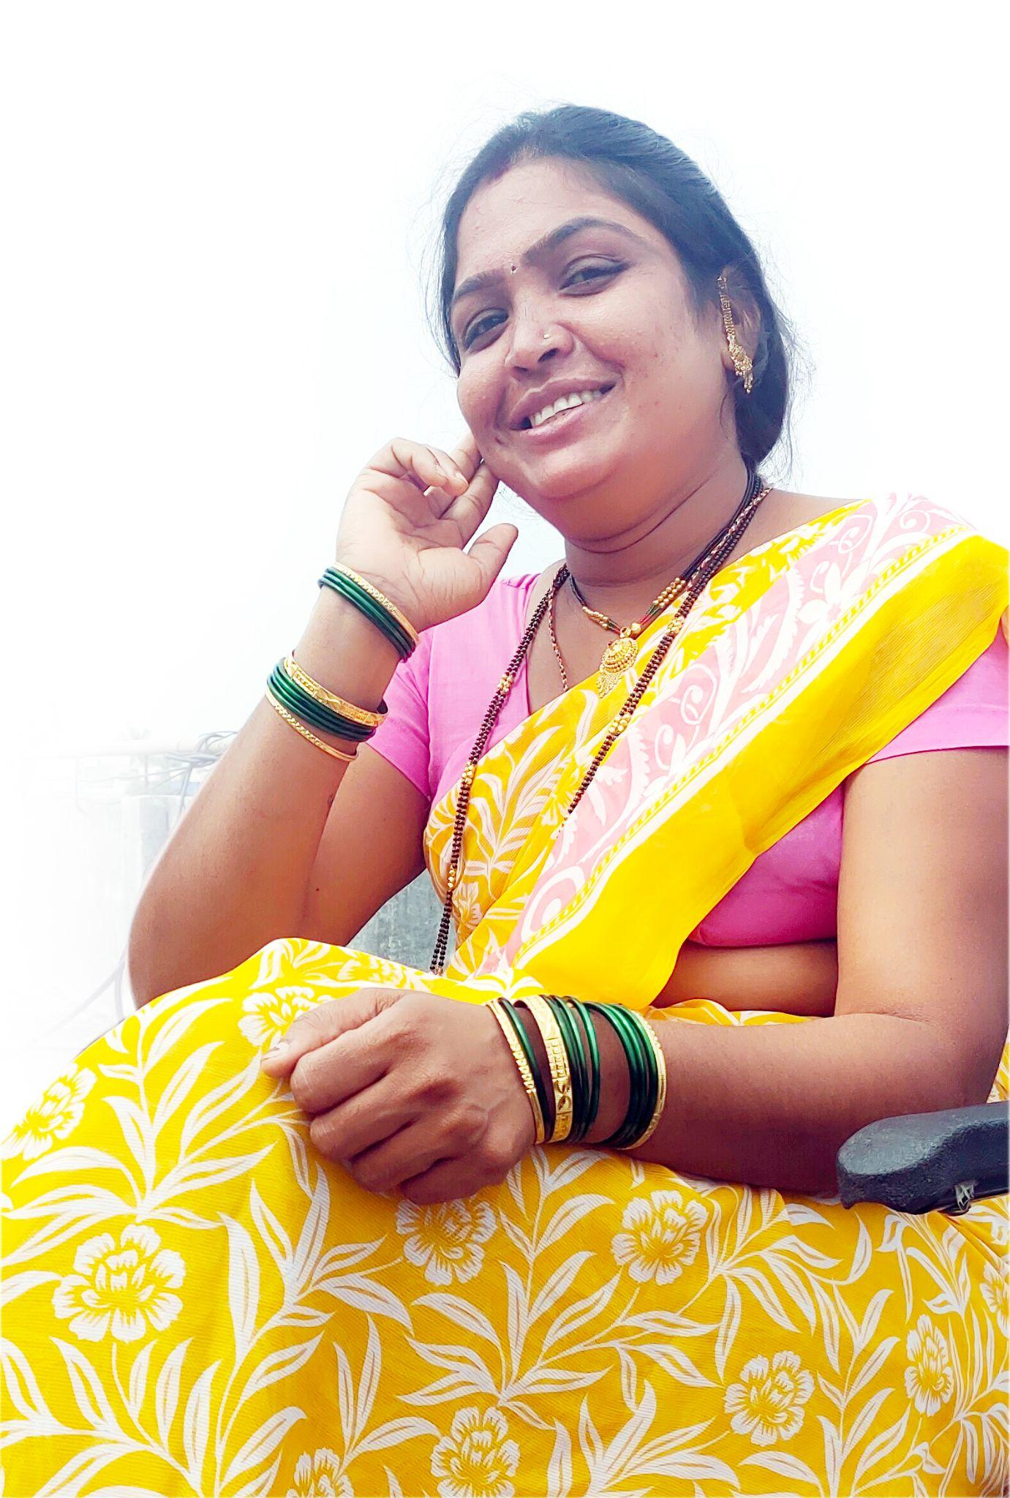
[Prior to becoming a waste picker], I needed to ask my mother-in-law if I could buy chicken, even how much chicken to put on a dish. Now I am making my own money and I have control of how I spend it. I am no longer dependent on anyone.
“[With waste picking], I am my own master. I make my own decisions. I will not exchange the freedom that comes with the work for anything.”
ANITA MAHADEV BHOSALE
Waste Picker
Pune, India

Slide 6
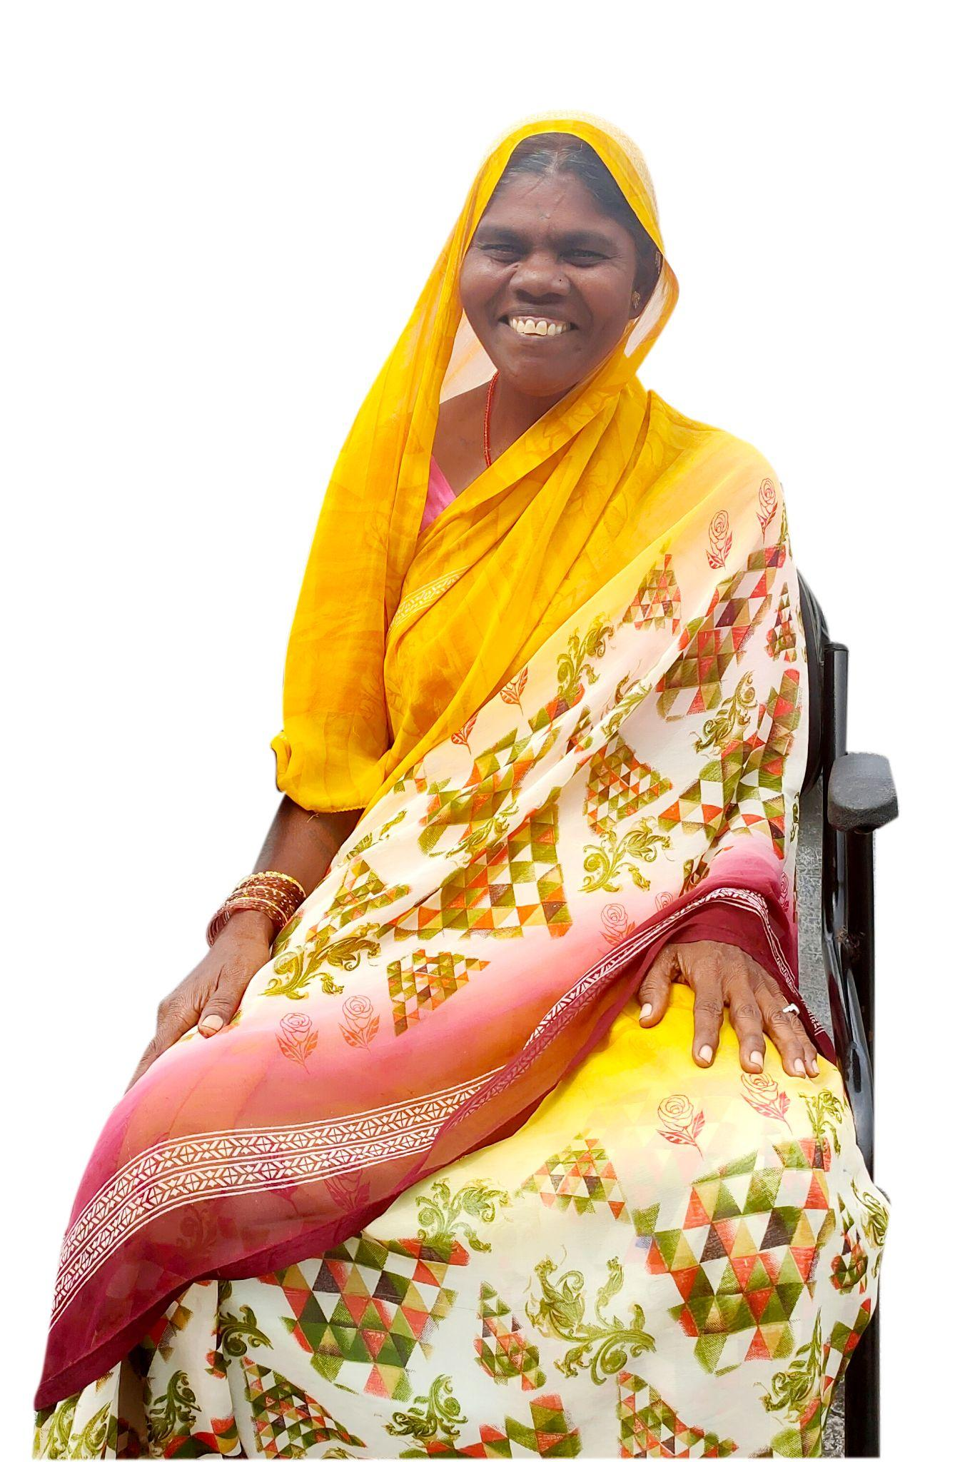
“The best part is that even when you are much older, you can still work. [This] is not the case with contractors and workers where there is an age limit. We hope we can be enrolled in some kind of pension scheme and get more support for our medical needs.”
ASHA BABAN ZOMBADE
Waste Picker, Pune

Slide 7
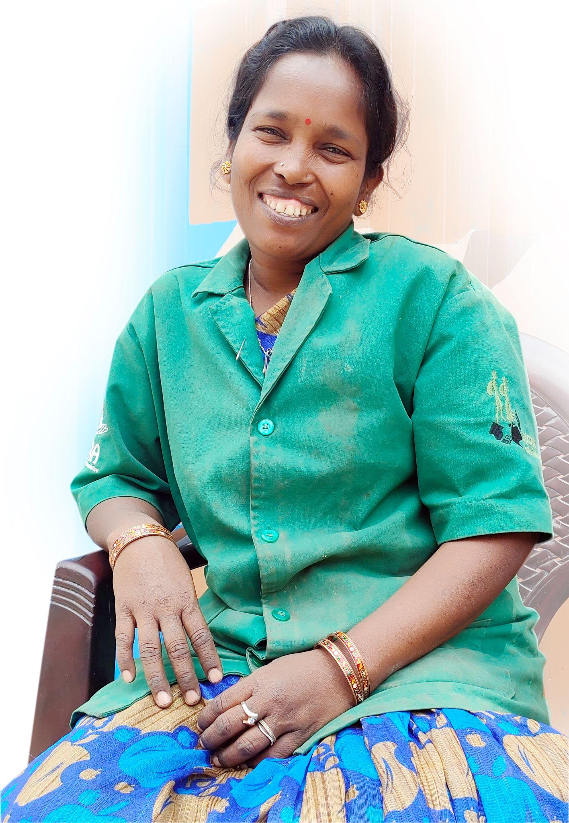
We are waste pickers. We contribute to the city. We protect the environment. If we stop working, there will be waste dumps everywhere. The city will become dirty. It will become stinky. People will get sick.”
ALUMELU
Waste Picker
Bangalore City, India

Slide 8
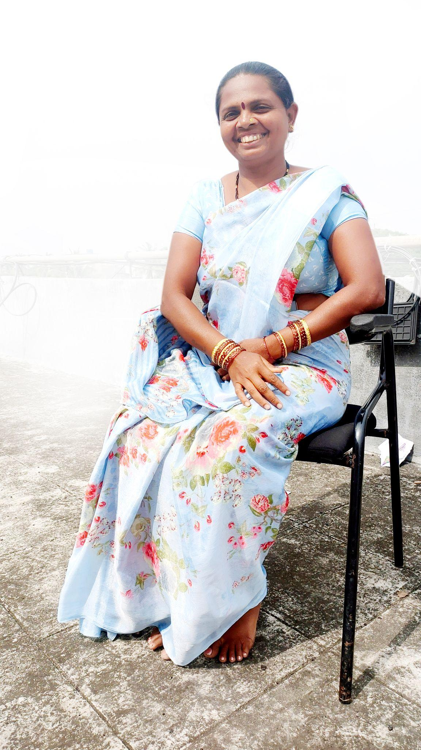
We understand that plastic is bad. We understand many of these issues. And you are asking if we want to end plastic. Sure, let’s end plastic. You’re asking about banning single-use plastic. Let’s ban single use plastic, but let’s do it in phases. Let’s look at the non-recyclable plastics. Plastic bags. Chips bags. We cannot sell these. We cannot profit from these. You phase out those first. Then you come to us to phase out other plastics.
But at the same time, think about the alternatives to plastic. Whatever system you are setting up as an alternative, on one side you think about banning plastic, and on the other hand you think what would become of the future and how we can be involved in that.
SARIKA BABAN GAIKWAD
Waste Picker, Pune

Slide 9
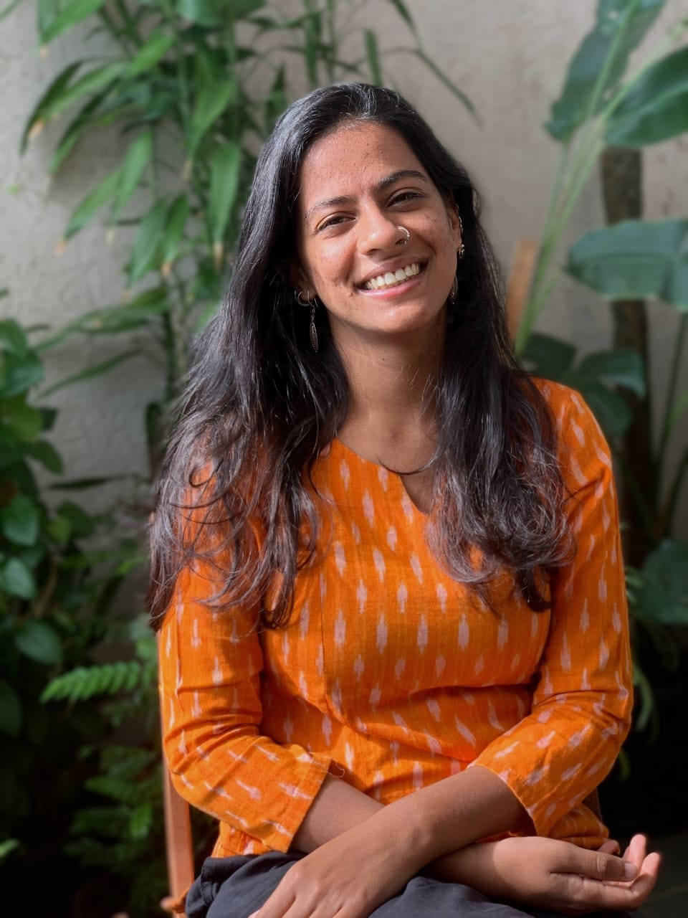
The sector is informal and therefore precarious, which means that recycling is happening, but there are a lot of hidden costs. Land is informal, don't follow environmental compliances. If you add up all of those costs, we don't know if the sector actually survives. We don't know whether the highly recycled materials are viable to recycle. So there's a lot of cost being absorbed and internalized to poor working conditions, long shifts, informal injurious conditions of work, and of course, no mechanism for Social Security benefits. Without just transition, waste pickers would be left in the cold and that's why we need just transition.
LUBNA ANANTKRISHNAN
KKPKP/SWaCH, Pune

Slide 10
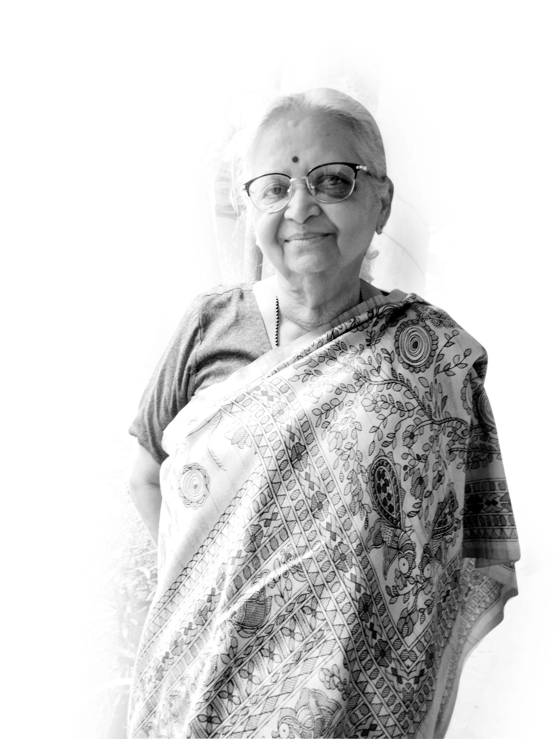
Unless women waste pickers are united, their problems will not be solved. Together, they can achieve a lot. We need to strengthen women's organizations not only at the city level, but also at the state, national and global levels.
JYOTI MHAPSEKAR
Co-Founder, Stree Mukti Sanghatana

Slide 11
On the third week of me working at Hasiru Dala, I was designing the house for a waste picker in the way I understand how houses are designed. I tried to explain to her, ‘this is a good house for you and this is how houses should be designed and everything.’
And she said to me, ‘I know you understand houses, but you don’t understand how I live.’ And this is how I want my house done’ and she started to sort of design the whole house. It’s not that she does not understand education and knowledge, but she knows exactly what she wants from her house.
KARTHIK NATARAJAN
Hasiru Dala Staff
Architect, Designer

